Slide 1
Week 12 Lab 2– Scripting Users
Databases Three

Slide 2
SQL Variables
DECLARE @variable Type
DECLARE @variable Type = value
DECLARE @find varchar(30)
DECLARE @find varchar(30) = 'New Zeal%'
SET @find = 'New Zeal%'
SELECT * FROM dbo.Country
WHERE Name LIKE @find

Slide 3
Variable Types
Any valid T-SQL data type
Int, decimal, money
Varchar,
Nvarchar (unicode)
Etc.
Table
User-defined table
http://msdn.microsoft.com/en-us/library/ms175007
http://msdn.microsoft.com/en-us/library/bb510489

Slide 4
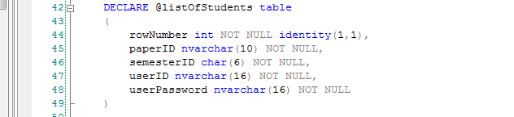
Table variable

Slide 5
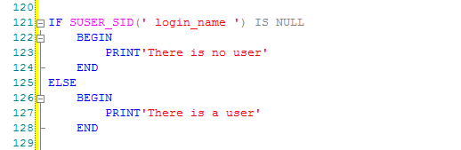
Control of flow
If..Else
Begin..End
Notes:
Imposes conditions on the execution of a Transact-SQL statement, can be nested.
The BEGIN and END statements encloses a series of Transact-SQL statements so that a group of Transact-SQL statements can be executed. Commonly used with conditional queries but have other uses

Slide 6
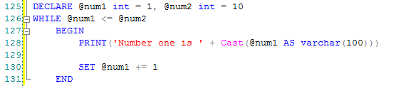
Control of flow
While
Notes:
Sets a condition for the repeated execution of an SQL statement or statement block. The statements are executed repeatedly as long as the specified condition is true. The execution of statements in the WHILE loop can be controlled from inside the loop with break and continue. You should use BEGIN and END otherwise expect great pain

Slide 7


Executing A String
We can assign a query to a string variable
Running is just as simple
Note the brackets (parentheses)

Slide 8



Exec A String 2
Passing in variables
Printing @sqlExecTemp returns
Which when run

Slide 9
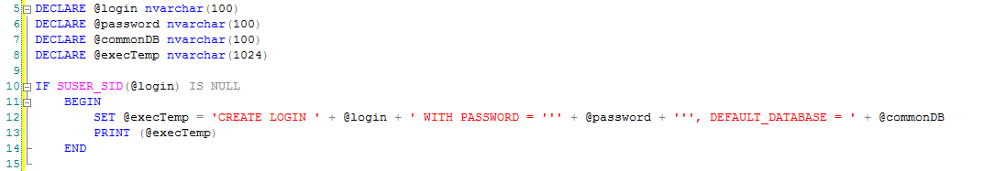
Multiple Logins Intro
Notes:
CHAR(39) returns a ‘

Slide 10
Problem
How do we get the users from the result set into the variables?
Table variable
Cursor – Are they BAD?
Read about it here: https://www.sqlshack.com/using-sql-server-cursors-advantages-and-disadvantages/

Slide 11
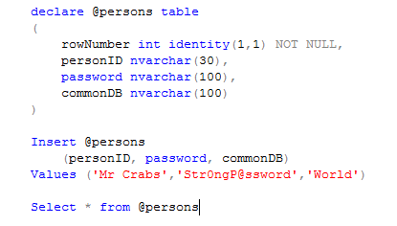
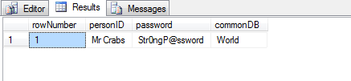
@table

Slide 12
Problem
How do we select off the table then?
IF EXISTS(SELECT * FROM @table)
BEGIN
Print(‘It works’)
END

Slide 13
Practical
Importing user CSV
“Selecting” rows into a new table
Creating the new users on the server

Slide 14
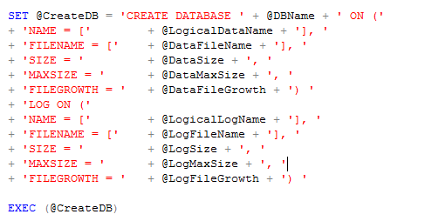
Databases - SQL
Create database syntax

Slide 15
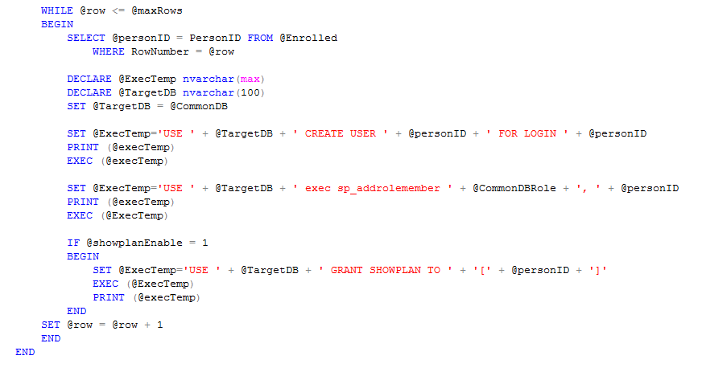
Adding Users

Slide 16
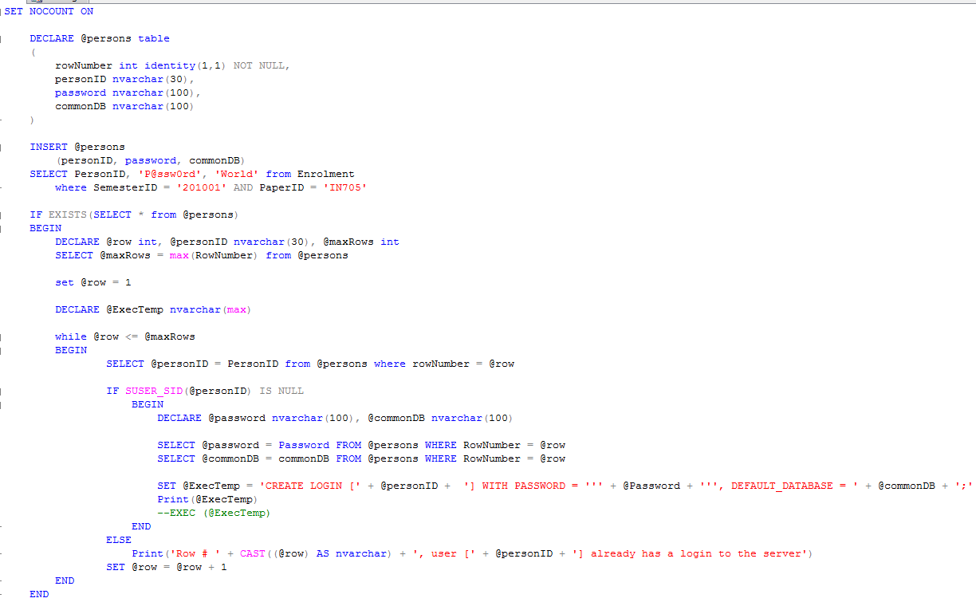
Adding Logons

